Slide 1


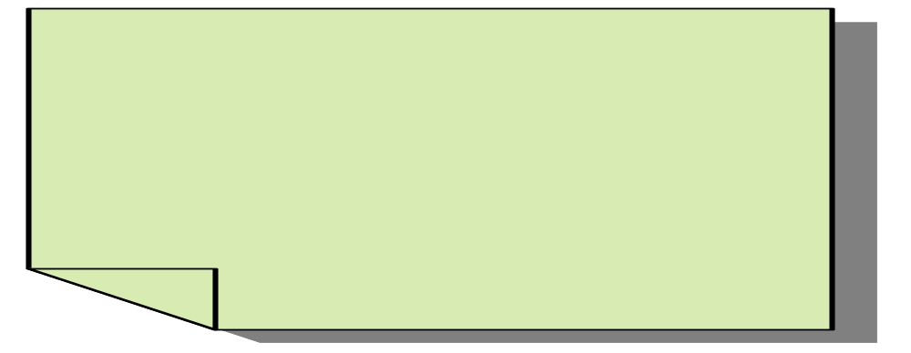

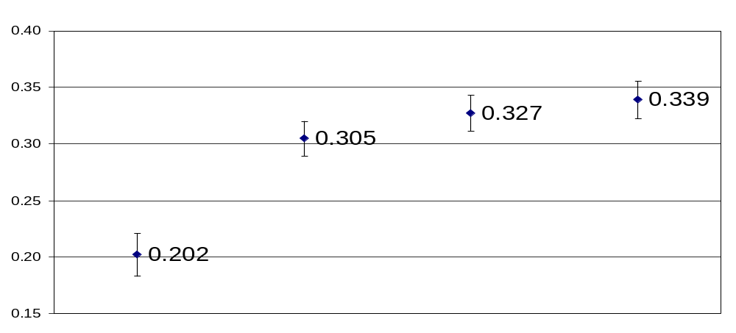
Multi-Document Summarization by Maximizing Informative Content-Words
Scott Wen-tau Yih Joshua Goodman Lucy Vanderwende Hisami Suzuki
Microsoft Research
Best result using a simple and principled method
Task: Multi-Document Summarization
What is a good summary?
Input: A set of similar documents
The quality of a machine-generated summary is judged by its similarity to human summaries
Automatic evaluation method – ROUGE scores
  Unigram or bigram co-occurrences between machine summary and human summary
Principle:
  Find words from the original documents that are likely to appear in human summaries
  Generate a summary that covers as many different important words as possible
We are dealing with structured output.
We develop a framework that allows predicting structured output with general constraints.
  Not only sequential constraints!!
The framework allows both
  Statistical constraints on variables
    Transition probabilities between states
    State-observation probabilities
  Declarative constraints on values of groups of variables
It automatically reduces to the simple case and incurs no additional cost when constraints are still sequential.ag
Example:
News articles about
Hussein’s death
Output: A short (e.g., ≤ 100 words) summary
Former Iraq dictator, Saddam Hussein, was hanged for crimes during his rule. Official said his body would be buried in the “next few hours.” After his execution, pictures of Saddam Hussein’s body has been shown by Iraqi TV…
Need to handle the (word) redundancy issue!
Estimate the scores of words
Generate the “best” summary
Important information
  Term frequency [Nenkova et al. SIGIR-06]
  Word position
Incorporate different kinds of information
  Discriminative scoring
    Encode information into features
    Predict the probability that the word will appear in human summaries using machine learning (e.g., logistic regression)
  Generative scoring
    Estimate probabilities using frequencies of words in the beginning of the documents
Objective:
  Maximize the sum of word scores
    We can’t pick a bag of important words…
    Select sentences instead!
Solve the knapsack problem
(Ignore the redundancy issue)
Sent. #1 (#words = 10, Σscores = 0.5)
Maximize Σscores
Cannot take more than 100 words
Sent. #2 (#words = 8, Σscores = 0.45)
Sent. #3 (#words = 5, Σscores = 0.35)
Sent. #4 (#words = 12, Σscores = 0.6)
Sent. #5 (#words = 20, Σscores = 0.8)
…
Handle the redundancy issue
Experimental results (DUC-04)
Use stack-decoder [Jelinek ‘69]
  A dynamic algorithm
  Penalize words that occur more than once in the search
  Equivalent to solving the knapsack problem if ignoring the redundancy issue
ROUGE-1 Scores
Baseline
First 100 words of the most recent document
Peer 65
Best DUC-04
system
DIS
Discriminative
scoring
DIS-SIM
Sentence simplification & discriminative scoring
Sentence simplification can help
Conclusions
Provide simplified sentences to select
in addition to the original sentences
  Eliminate syntactic units based on predefined heuristic templates
  Goal: shorten the length but still keep the important words (information)
Excellent results
  Best ROUGE-1 for DUC-04 & MSE-05
  Very simple method (~600 lines of code)
Future Work
  Task-focused summarization

